Slide 1
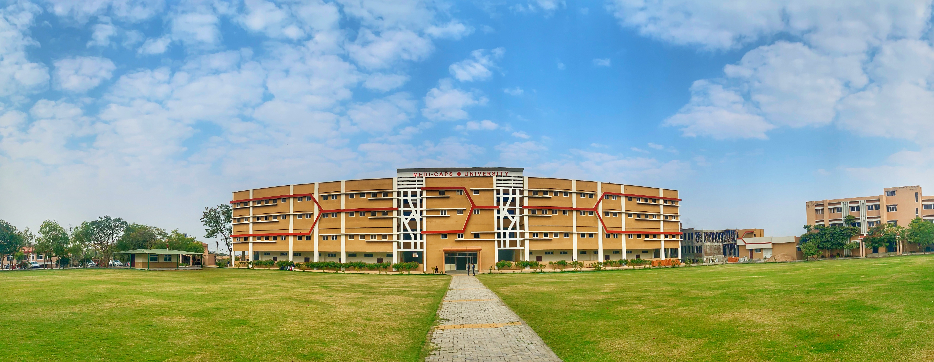

Project Work - II
Image Capture Application
Department of Information Technology Engineering
Faculty of Engineering
MEDI-CAPS UNIVERSITY,INDORE 45331
MARCH-2021
Sraddha Sharma
EN17IT301100
Under the Guidance of
Vidhya Samad Mam
Notes:
Sample slide

Slide 2

About the Industry
Xoriant is a Silicon Valley headquartered in California product engineering, software development, and technology services firm with offices in the U.S., Europe, and Asia. For both technology companies and enterprises, from startups to the Fortune 100, we leverage our expertise in emerging technologies and our high performing teams to deliver innovative solutions that accelerate time to market and keep our clients competitive.
Across all our technology focus areas – Product Engineering, DevOps, Cloud, Infrastructure & Security, Big Data & Analytics, Data Management & Governance, Digital, and IoT – every solution we develop benefits from our product engineering.
Our customers range from startups to Fortune 100 and encompass BFSI, High Tech, Healthcare, Pharma, Industrial Manufacturing, Telecommunications, and Automotive sectors.
Girish Gaitonde-Founder & CEO
Started Date- 18th January
End Date -18th May
Stipend- 10,000 Rs

Slide 3
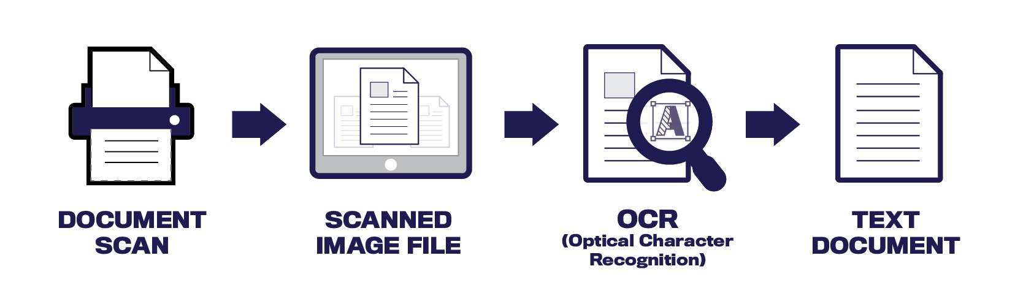
Abstract
The project is about Image Capture Application. It is a process of classifying optical patterns with respect to alphanumeric or other characters. This application includes the Optical character recognition process which does the segmentation, feature extraction and classification of the image or document file.
This application converts Analog text based resources to digital text resources. And then these converted resources can be used in several ways like searchable text in indexes so as to identify documents or images. As the first stage of text capture a digital copy of a page is taken. And this scanned copy will form basis for all other stages.
The very next stage involves implementation of technology Optical Character Recognition for converting text content into machine understandable or readable format
Notes:
Sample Slide

Slide 4
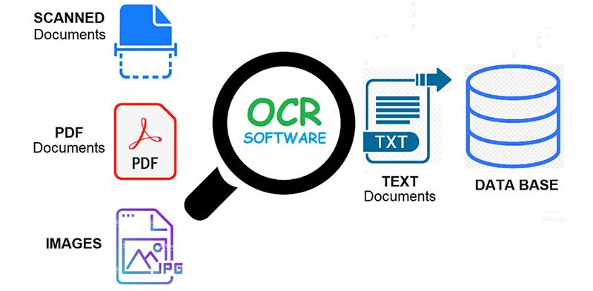
Synopsis
Introduction
Image Capture Application intuitively helps transform your paper-based business processes by leveraging best of breed OCR technology. Captures, classifies, and recognizes text.
Image Capture Application is a Microsoft Azure based intuitive document digitization solution. It uses Microsoft Azure OCR services to extract printed/ handwritten text images (key-value pairs) from images and multi-page documents. This information can be stored in structured databases and analyzed using various tools for trending, dashboards, and reporting.
Sometimes in this document processing we need to process the information. For this document processing we need a software system called IMAGE CAPTURE APPLICATION. This process is also called DOCUMENT IMAGE ANALYSIS (DIA). Thus our need is to develop character recognition software system to perform Document Image Analysis which transforms documents in paper format to electronic format.
Notes:
Two levels

Slide 5
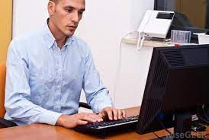
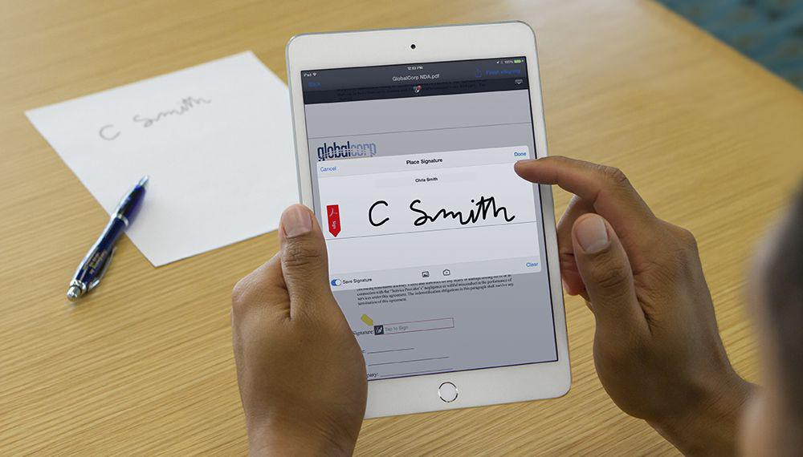
Problem Domain
The main purpose of Image Capture Application based on a infrastructure is to perform Document Image Analysis, Text processing of electronic document formats more effectively and efficiently.
To improve the accuracy of recognizing the characters during document processing compared to various existing available character recognition methods.
The primary objective is to speed up the process of character recognition in document processing. As a result, the system can process a huge number of documents with-in less time and hence saves time.
To eradicate human error and reduce manual efforts.

Slide 6
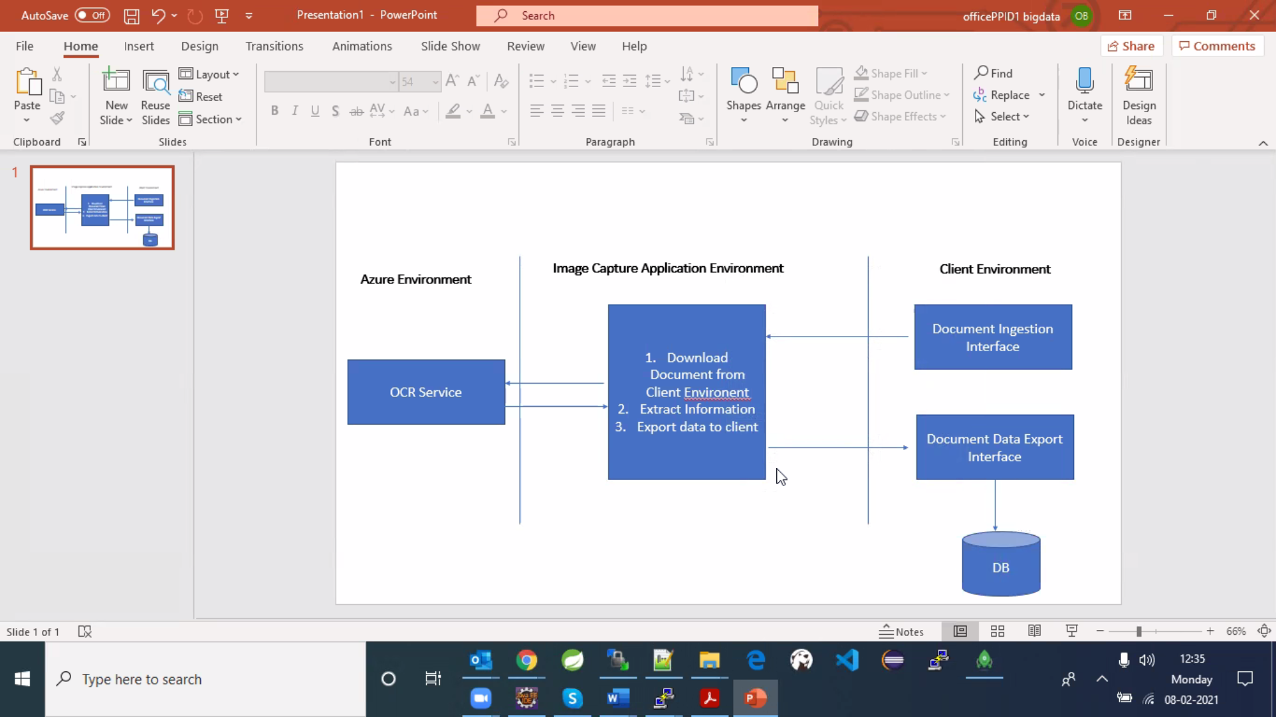
Solution Domain
It can widely used as a form of data entry from printed paper data records – whether passport documents, invoices, bank statements, computerized receipts, business cards, mail, printouts of static-data, or any suitable documentation.
It is a common method of digitizing printed texts so that they can be electronically edited, searched, stored more compactly, displayed on-line, and used in machine processes such as cognitive computing, machine translation, key data and text mining.
Gives solution to “Big Data” for leading companies in pattern recognition, artificial intelligence and computer vision.
Behavioral Diagram

Slide 7




System Domain
Technologies used includes:
Spring Boot
Flask
Microsoft Azure OCR
Java Frameworks
Postman
Languages Used:
Java
Python
Node
HTML,CSS and JavaScript
Software Used:
STS Spring Tool Suite – 4.9.0
Visual Studio Code – 1.53.0
Microsoft Azure OCR
OS - Windows 10
Postman – 7.36.4

Slide 8
Application Domain
OCR engines have been developed into many kinds of domain-specific OCR applications, such as receipt OCR, invoice OCR, check OCR, legal billing document OCR.
They can be used for:
• Data entry for business documents, e.g. Cheque, passport, invoice, bank statement and receipt
• Automatic number plate recognition
• In airports, for passport recognition and information extraction
• Automatic insurance documents key information extraction
• Traffic sign recognition.
• Extracting business card information into a contact list.
• More quickly make textual versions of printed documents.

Slide 9
Expected outcome
Reduces human error
Automatically fetch the details
Saves time
Reduces human involvement
Cost effective
Highly secure
Highly defined and accurate data as per client need in client environment.

Slide 10
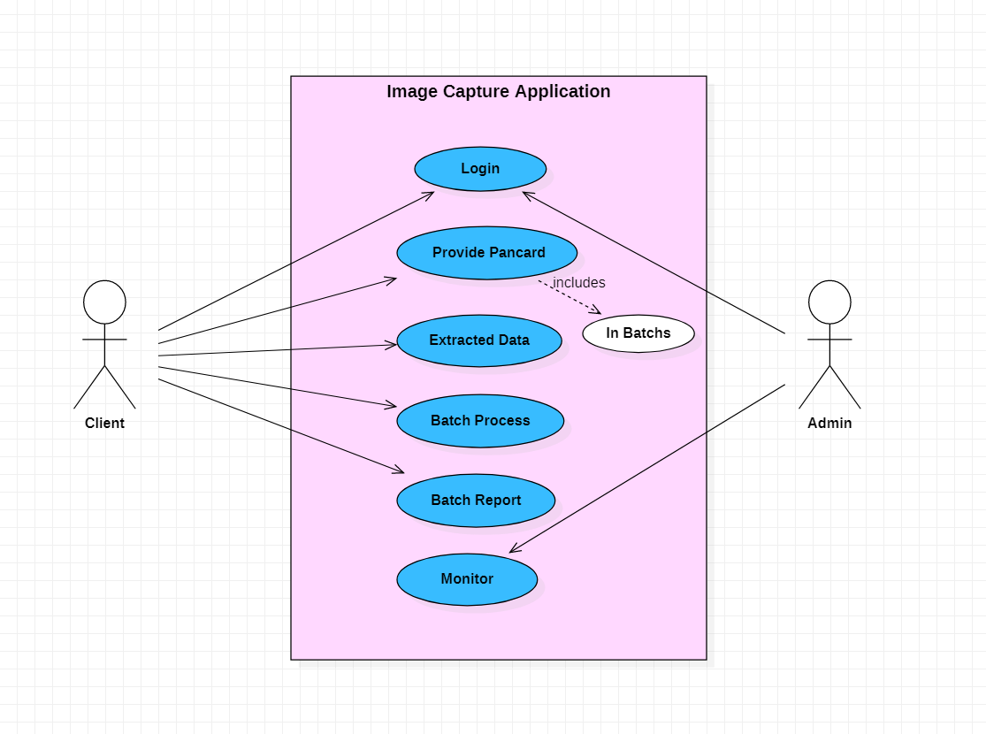
DIAGRAMS: Use Case Diagram

Slide 11
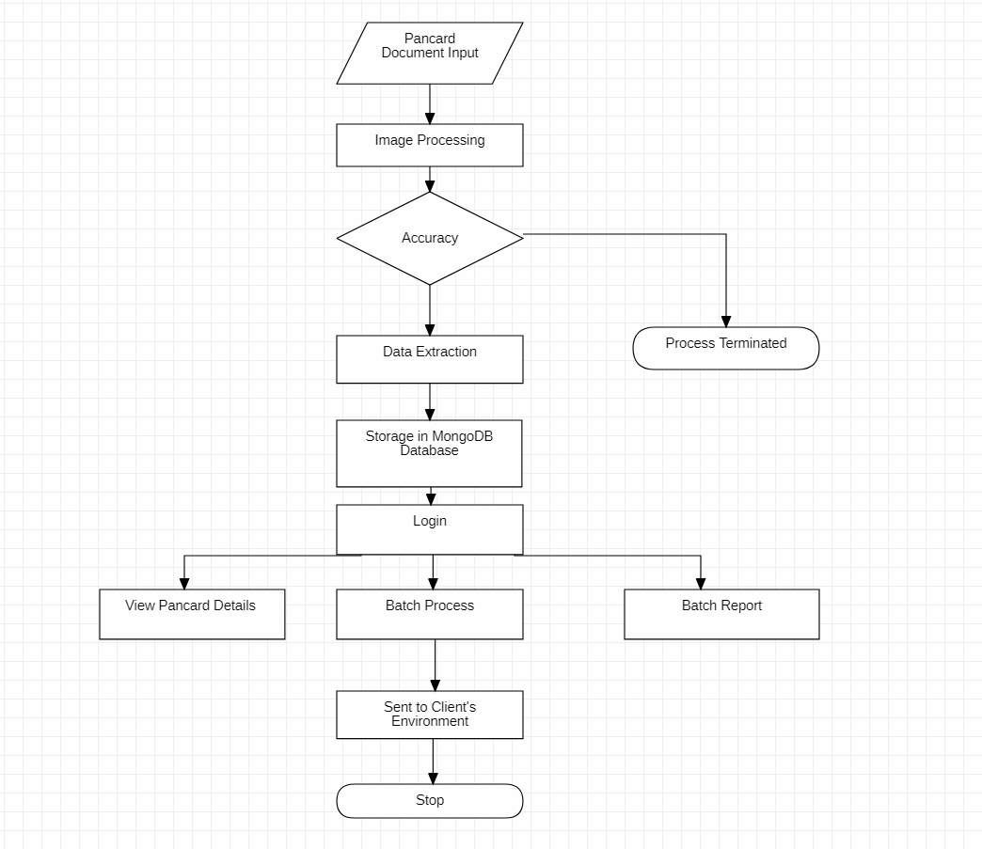
FLOW CHART-

Slide 12
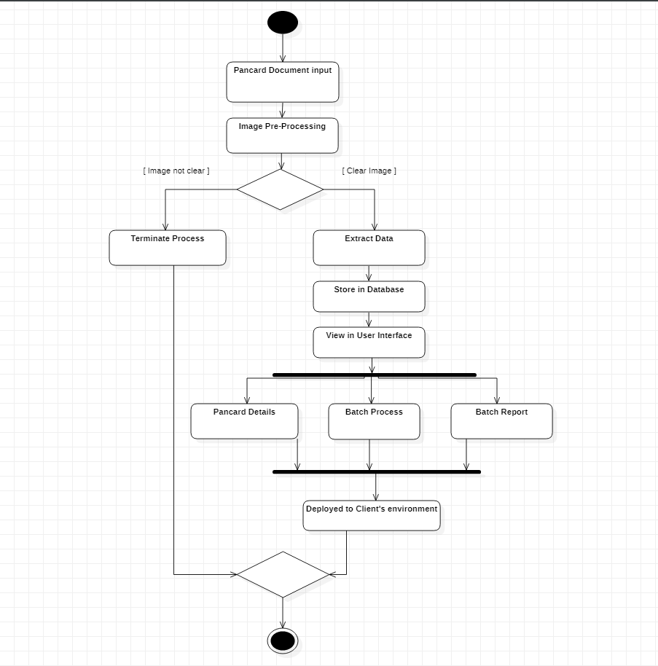
ACTIVITY DIAGRAM:

Slide 13
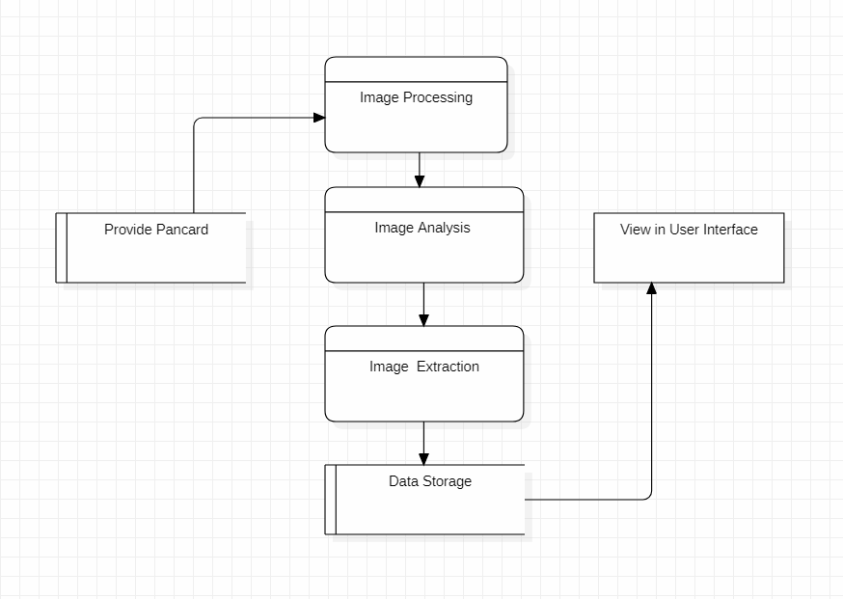
DATA FLOW DIAGRAM:

Slide 14
Implementation
Deployment steps of Project :-
First we need to install Spring Tool Suite, Visual Studio Code, Postman , MongoDB (Compass/Atlas) and Xampp software in your PC/Laptop.
Start the Xampp Tomcat Server, goto the file where you have pancard documents, hit the api in Visual Studio Code to fetch all the documents,verify through Postman and goto Spring Tool Suite and run the Image Capture Application.
All the files that you have fetched will be downloaded in the directed folder and then the data will get extracted.
Extracted data will get stored in the MongoDB database in the form of collections.
Then, we created a GUI for presenting our implementation which contains the Pancard Details, BatchProcesses and Batch Reports.
After getting logged in the three services will be visible and you can view them.

Slide 15
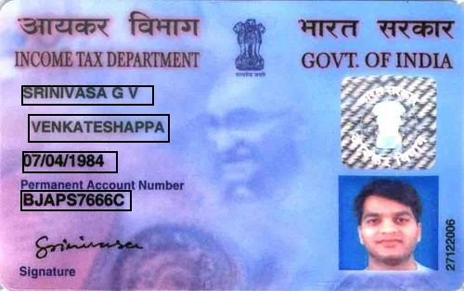
Implementation continued:
Name of Person
Father’s Name
Date Of Birth
PAN Number
Pancard of an Individual

Slide 16
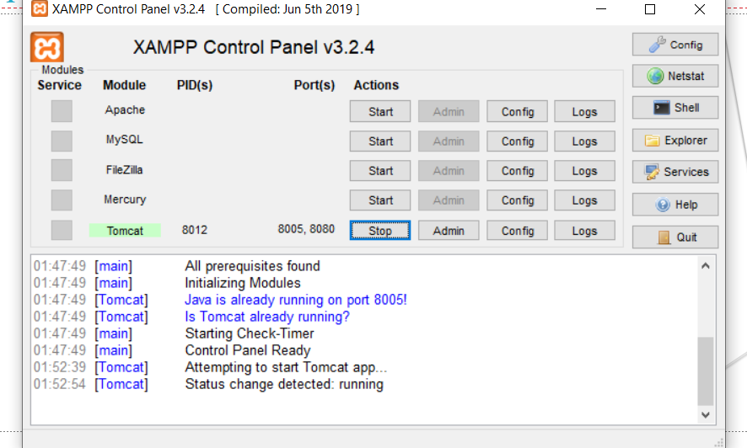
Local Server -Xampp

Slide 17
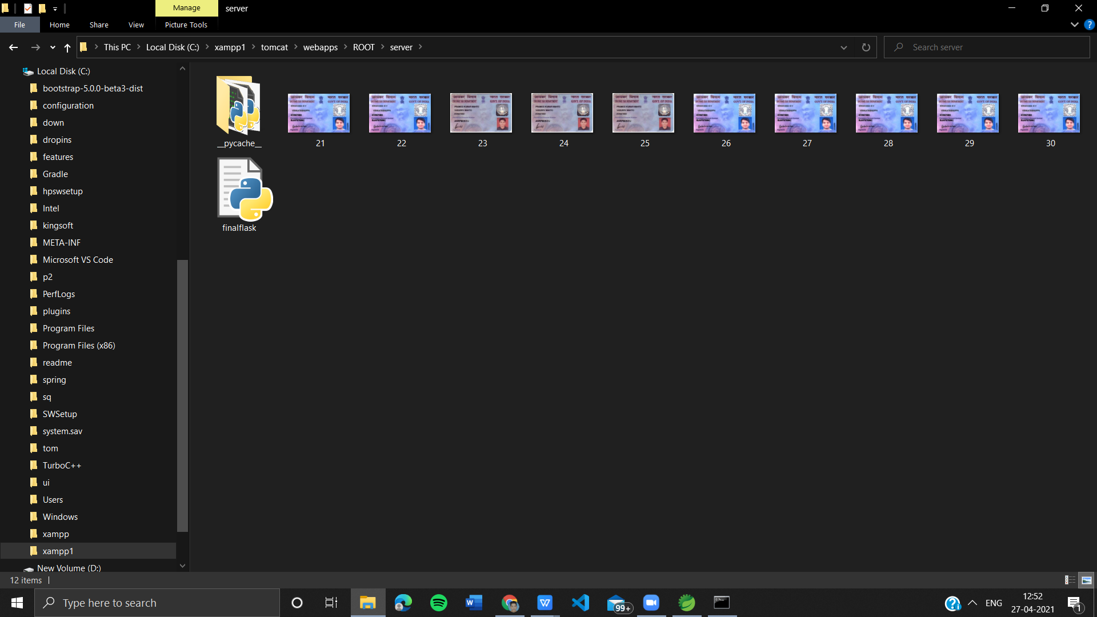
Local Storage

Slide 18
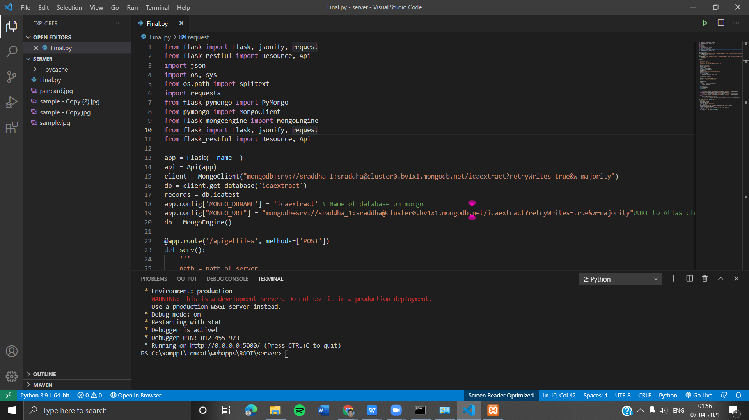
Api to extract files from storage

Slide 19
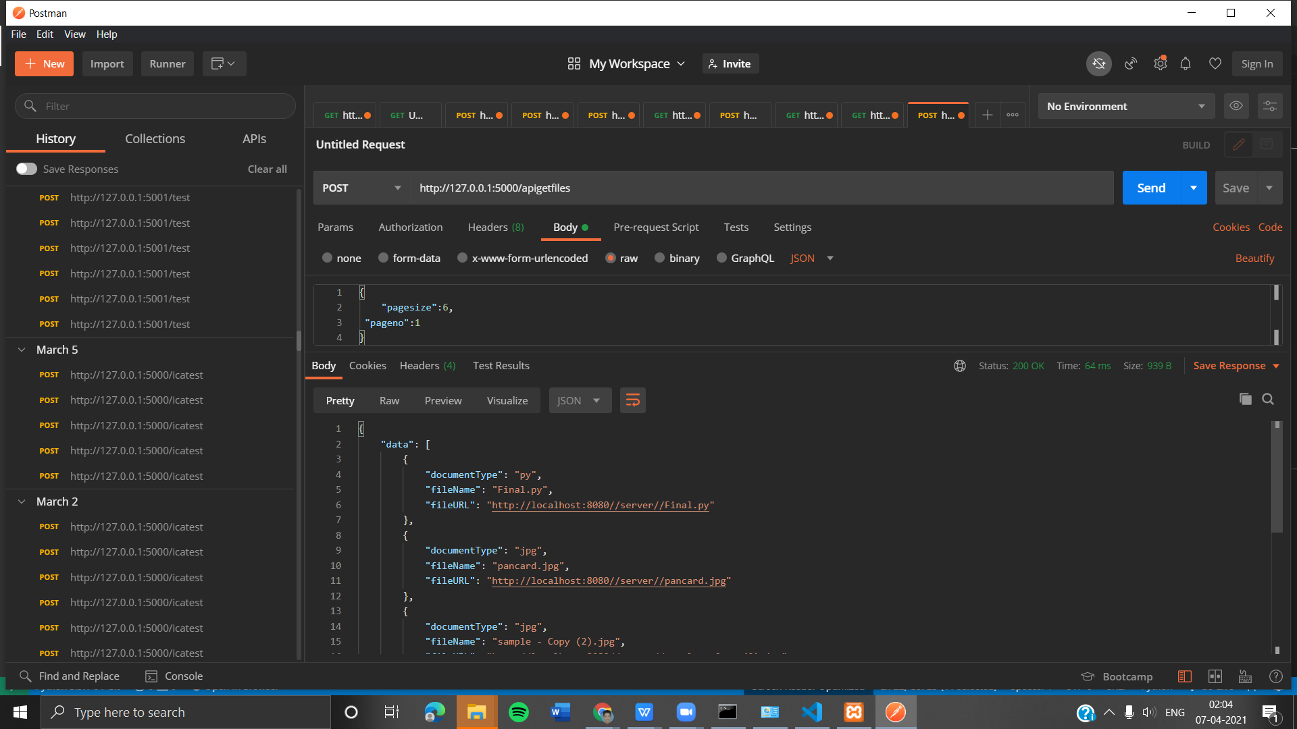
Through postman we can check

Slide 20
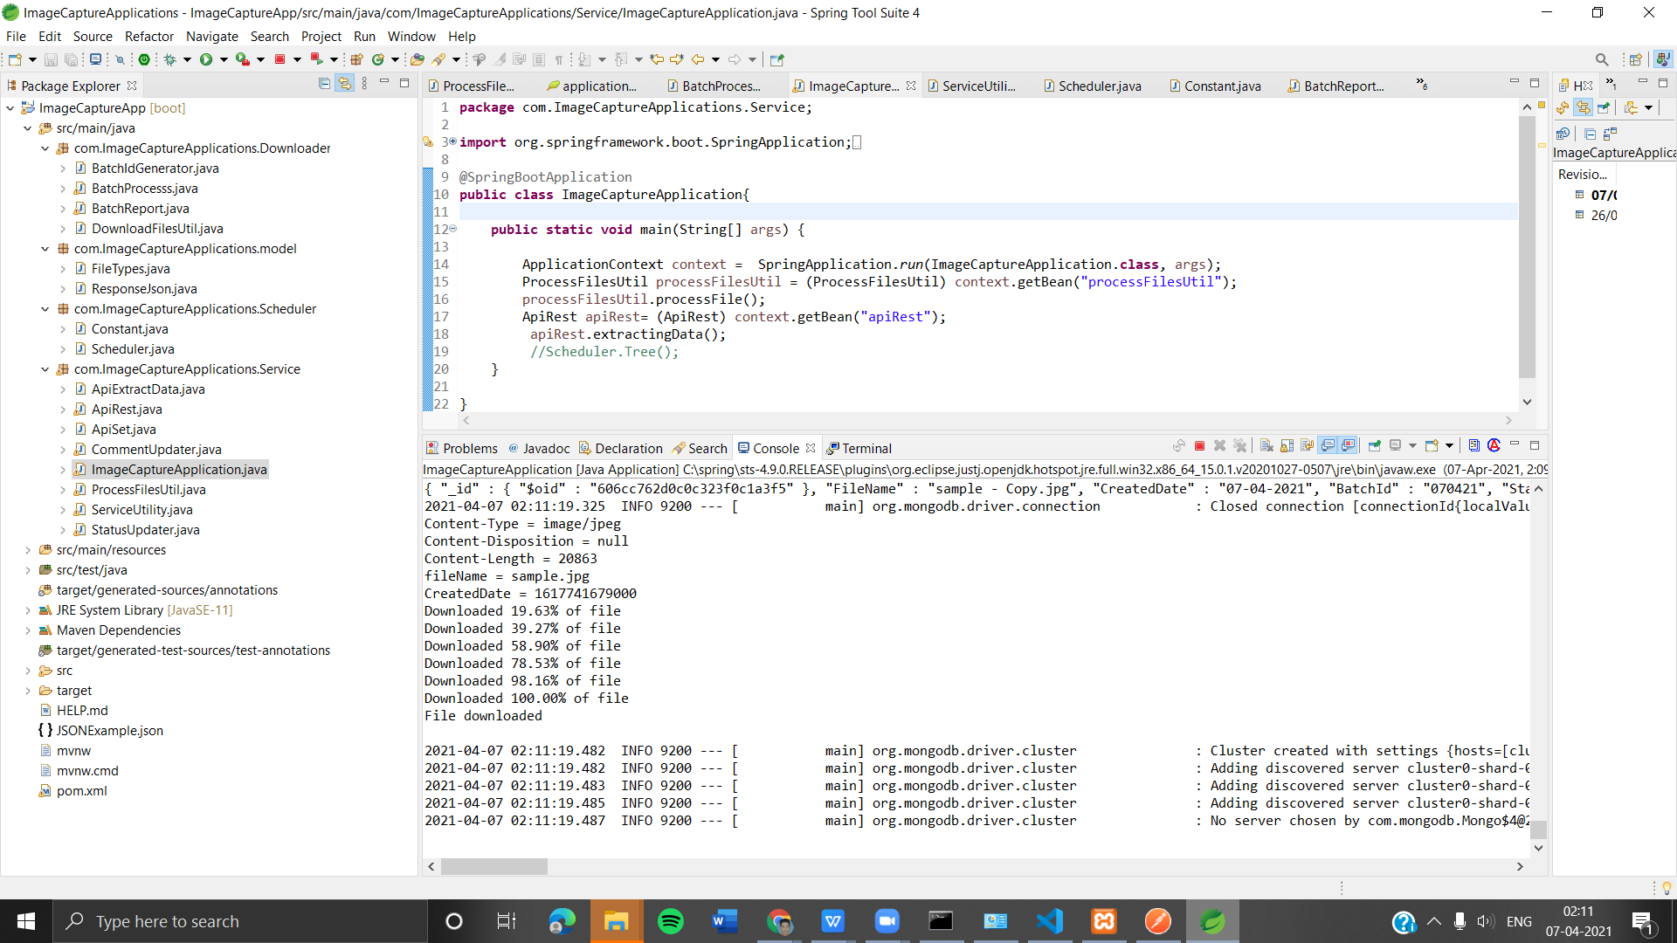
Application Overview

Slide 21
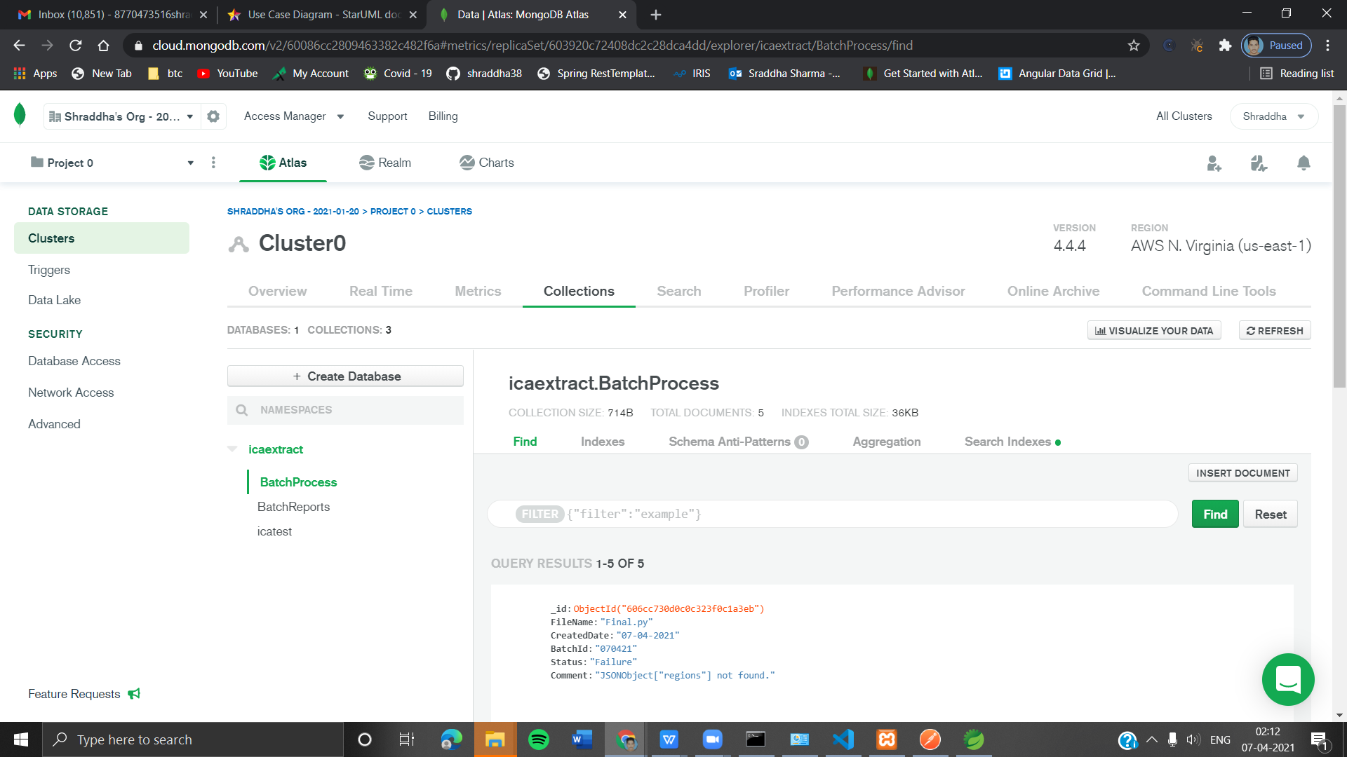
MongoDB Atlas Cloud Storage

Slide 22
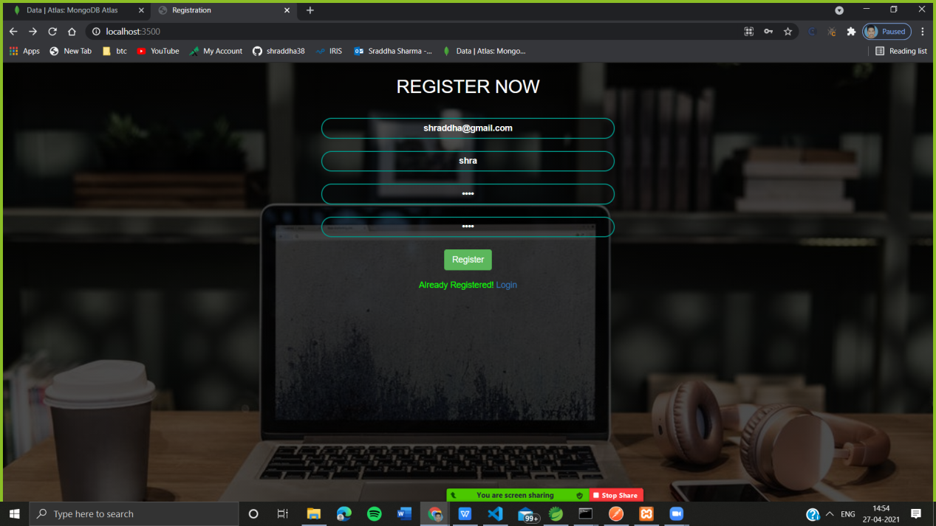
Front-End
Register Page

Slide 23
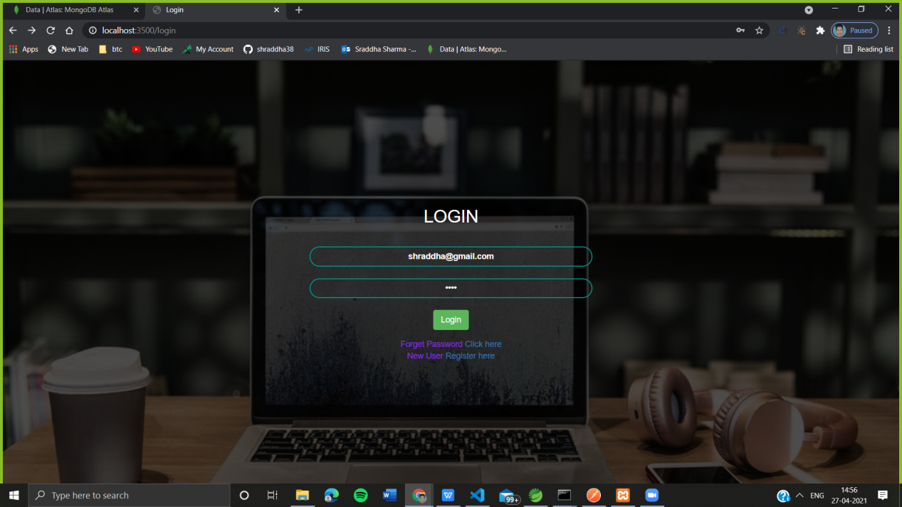
Login Page

Slide 24
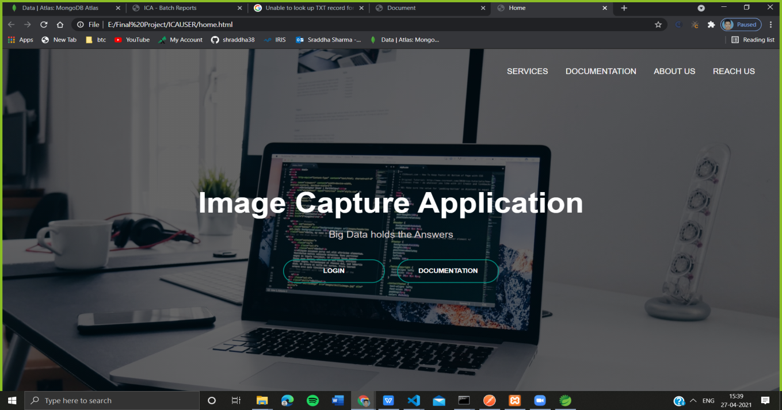
Home Page

Slide 25
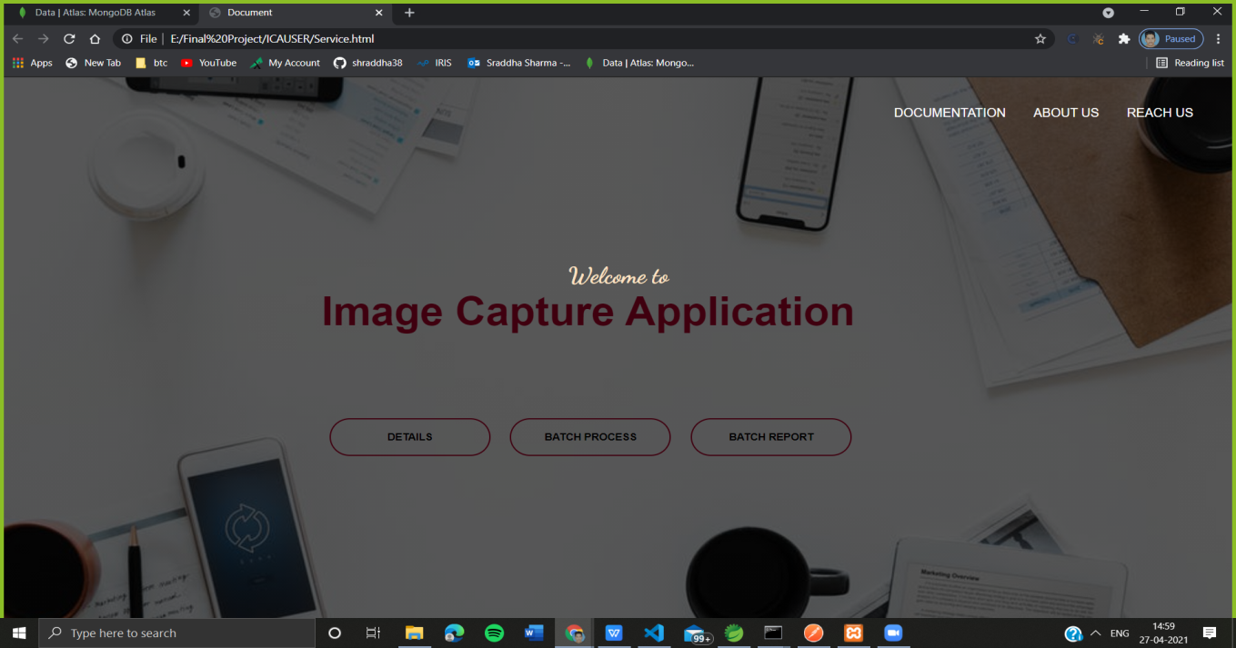
Service Page

Slide 26
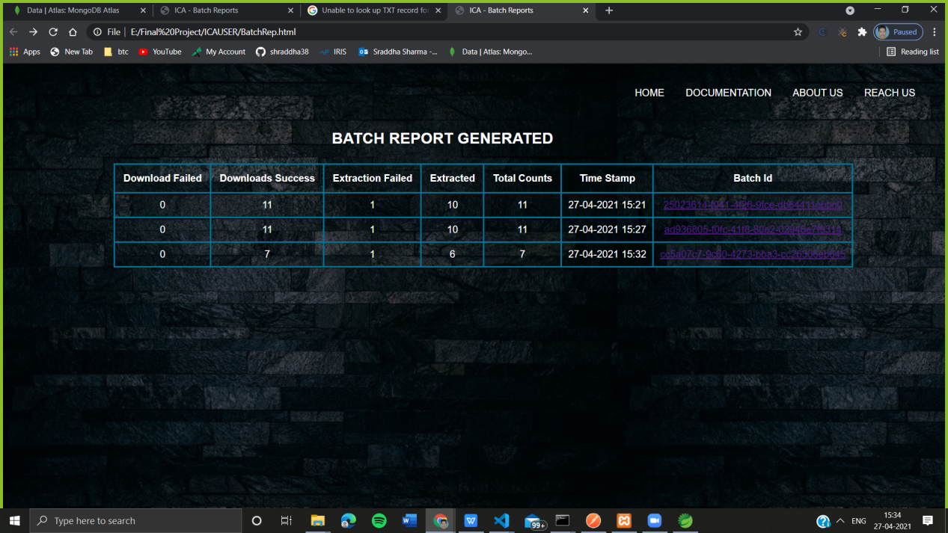
Batch Reports Of Processes

Slide 27
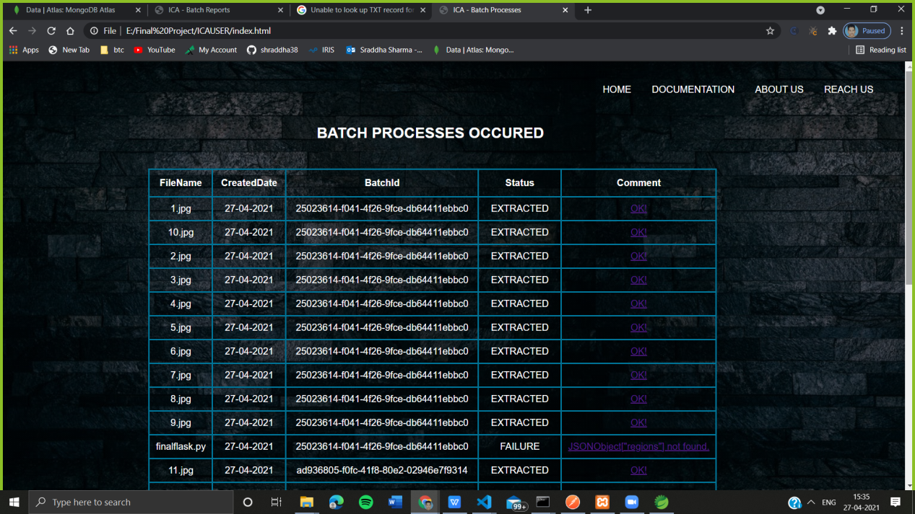
Batch Processes of Pancards

Slide 28
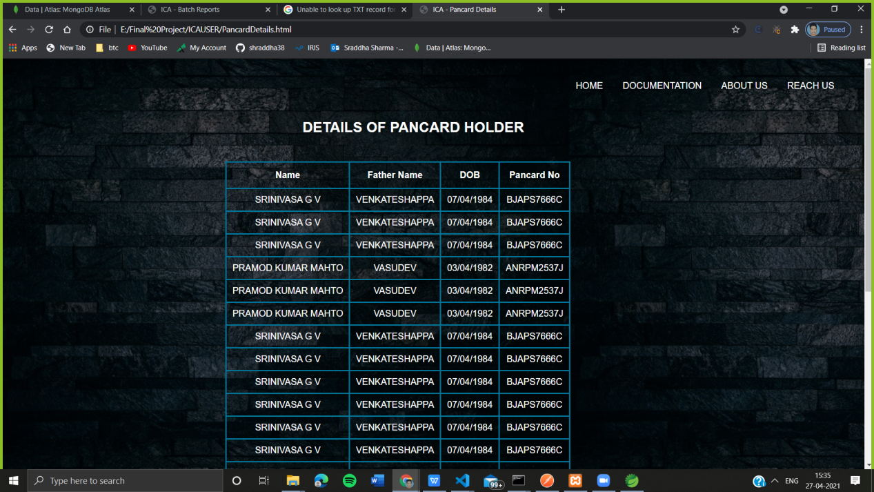
Pancard Details

Slide 29
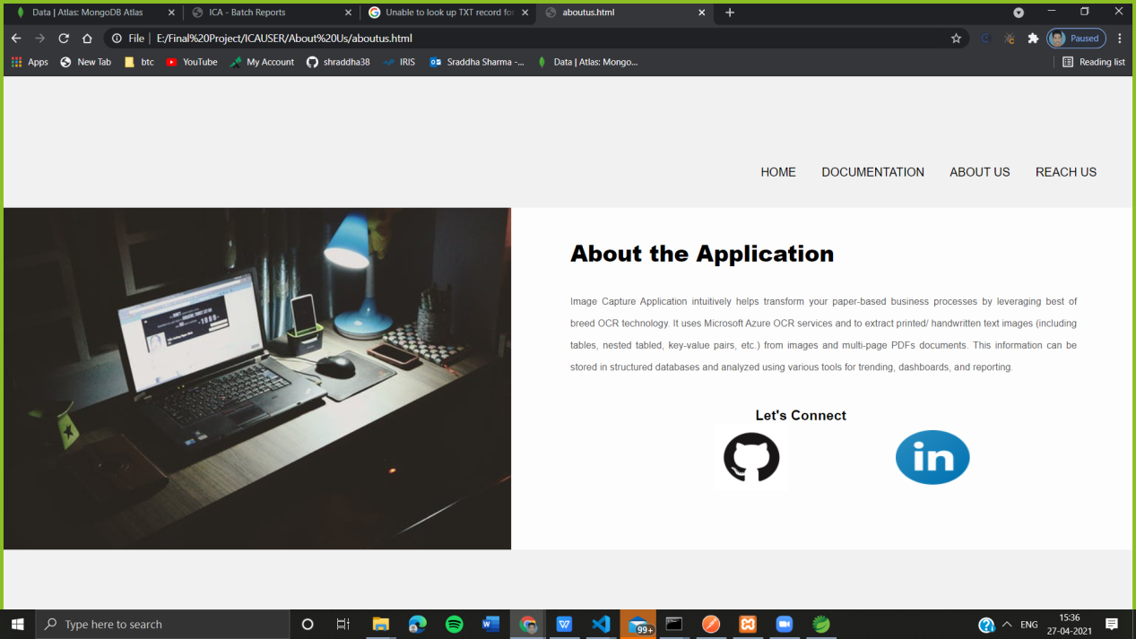
About Us Page

Slide 30
Testing
Case 1: Login and Registration
S. No | Input Description | Expected Output | Pass/Fail
1 | If username entered is valid | Successful | Pass
2 | If password entered is valid | Successful | Pass
3 | If Email entered is already in use | Error | Pass
4 | If Email is not registered | Error | Pass

Slide 31
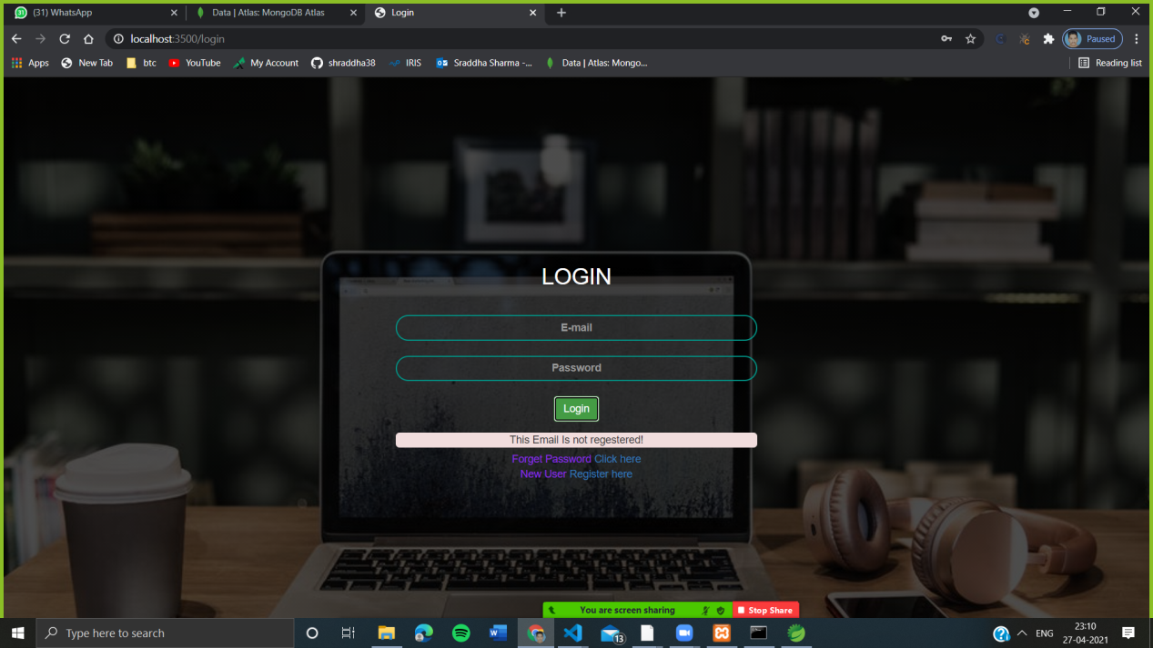
If Email is not registered

Slide 32
Case 2: Application
S. No | Input Description | Expected Output | Pass/Fail
1 | If No file is present in the Local Storage | No File Found | Pass
2 | If there are 20 files or less | Extracted and Stored | Pass
3 | If the file other than type of JPEG/PNG | Extraction Failed | Pass
4 | If the image is Blurred | Extracted and Stored | Fail

Slide 33
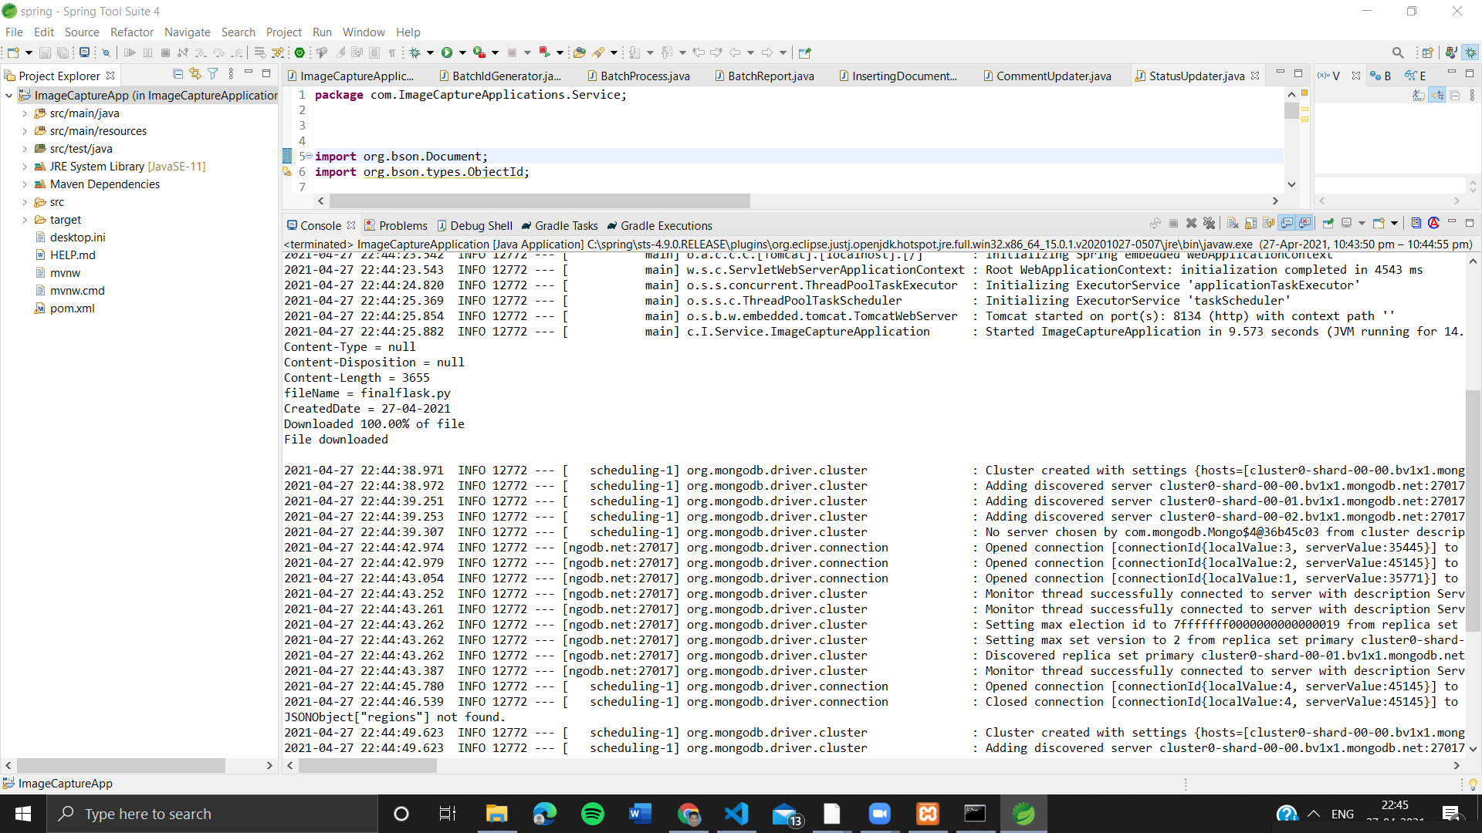
If the file other than type of JPEG/PNG

Slide 34
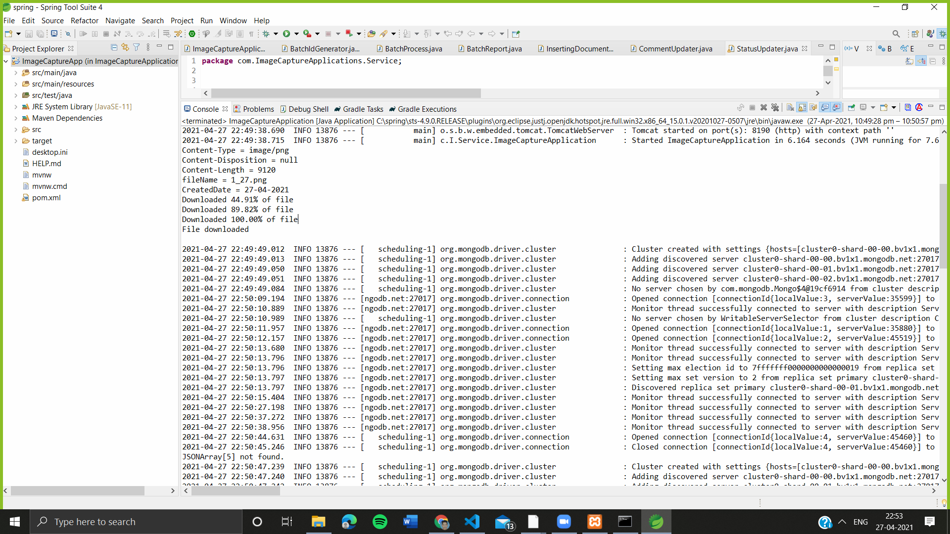
If the Image of Pancard is Blurred

Slide 35
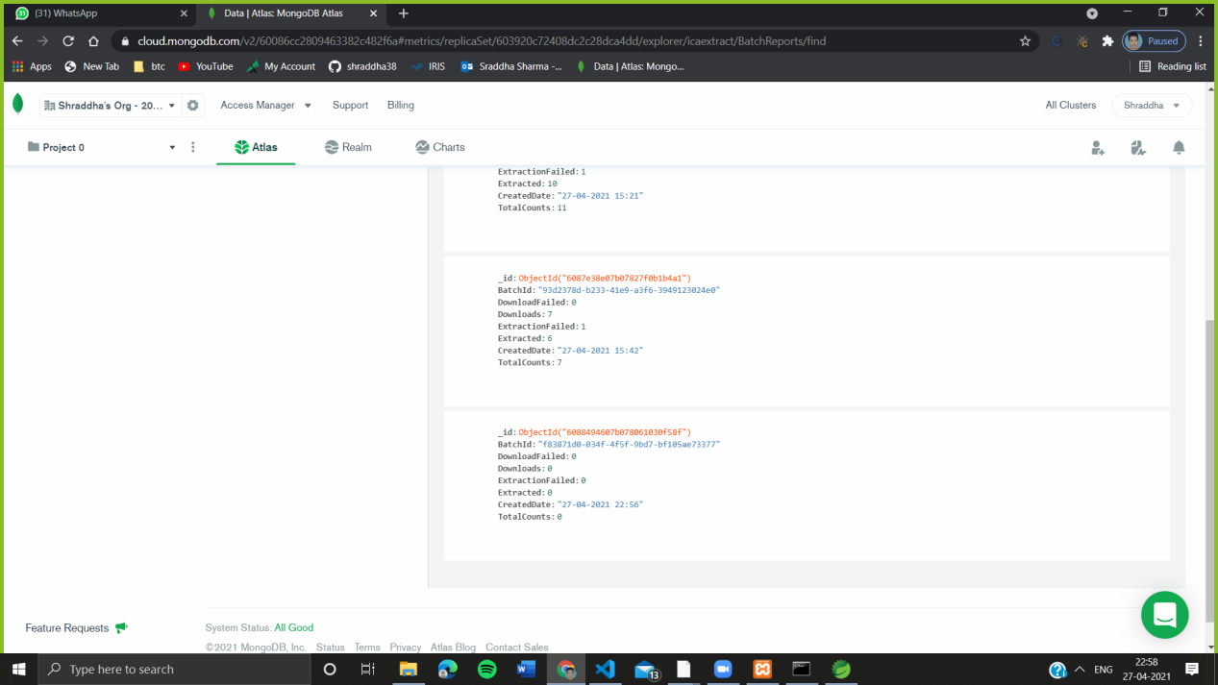
If No file is present in the Local Storage

Slide 36
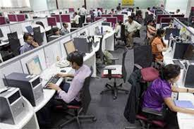
Future Scope
Will include every Government of INDIA’S issued documents
Aadhar Card
Passport
Driving License
Font Independent OCR
Automatic number plate recognition
In airports, for passport recognition and information extraction
Traffic sign recognition.
Health Care firms.
Successfully will remove

Slide 37

Conclusion:
Our application Image Capture Application intuitively helps transform your paper-based business processes by leveraging best of breed OCR technology. Captures, classifies, and recognizes text.
To reduce manual efforts
To visualize data in a simpler manner
To do fast documentation and data extraction
To automate the process of feeding the data extraction and storage.
To reduce the human error and improve accuracy.
To deploy the details to Client’s environment in the form of Batch Reports.

Slide 38
Refrences
OCR Azure Documentation- https://docs.microsoft.com/en-us/azure/cognitive-services/computer-vision/overview-ocr
Research on Text Detection and Recognition Based on OCR Recognition Technology- https://ieeexplore.ieee.org/document/9236870
Xoriant’s Product- https://azuremarketplace.microsoft.com/en-us/marketplace/consulting-services/xoriantcorporation.xoriant_smart_capture
Spring Documentation- https://spring.io/guides#tutorials
Notes:
Sample Slide

Slide 39
Thank You
Sraddha Sharma
EN17IT301100
en17it301100@medicaps.ac.in

